Slide 1
The Hard Systems Methodology
Chapter 6
Serhat Can

Slide 2
Complex Problems
Formal problem-solving is likely to be effective only in cases where;
- uncertainty about the “problem” and possible solutions is minimal
- the problem setting is stable
- the level of complexity is low

Slide 3

Complex Problems
Solution may not work at all, or may work counter-intuitively and make the problem worse, or may produce unexpected new problems

Slide 4

Example: Public Transport Problem
Railway companies in Britain tried to solve the ‘overcrowded trains issue’ by increasing the number of carriages on an early morning train.
Result
No, the extended train also became very overcrowded each day.
Some travellers who had previously switched to an earlier train switched back to their preferred train.

Slide 5
Example: Traffic Accident Problem
When accident black spots are treated to reduce accidents, the number of accidents at such locations goes down.
Result
The drivers are increased attention at treated black spots and then relax their attention elsewhere.
The number of accidents at untreated locations in the vicinity corresponding increase.
Migration of the traffic accident problem

Slide 6

Need for
Systemic Intervention
WHO’s intervention into a public health problem «insect-borne disease» in Borneo.
spraying all such dwellings with DDT
Result: Occurrence of unexpected problems

Slide 7

Need for Systemic Intervention
Systematic procedures such as formal problem-solving are inadequate for tackling real-world problems
Complex relationships exist
Simplistic assumptions are unwarranted

Slide 8
Need for Systemic Intervention
HARD SYSTEMS methodology tries to avoid the pitfalls of oversimplifying the problem by
adopting a series of steps designed to develop a wider, systemic perspective and awareness of all the significant aspects of the problem situation.

Slide 9
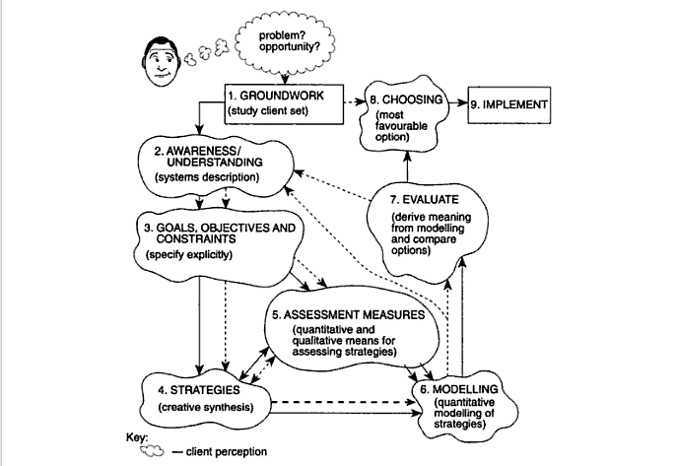

Slide 10
Step 1 Groundwork
Identifying and establishing working relationship with the client-set
Establish various interests:
who ‘owns’ the SYSTEM concerned
who ‘owns’ the ‘problem’
who can give or withhold approval
what attitudes are prevalent

Slide 11
Step 1 Groundwork
There are 3 practical ways to clarify the nature of the problem:
First action is to agree formally with the client-set what project topic is and its likely scope
Second action is to find out the client-set’s world-view in relation to the task and whether there is general agreement about the nature of the current position.
Third action is to find out as early as possible what the client-set would consider to be successful outcome.

Slide 12
Step 2 Awareness and Understanding
Enable the analyst to gain a clear perspective of where the problem fits and possible effects of solving the problem
The aim is to reduce the number of counter-intutive outcomes of any change, or at least anticipate those outcomes.
Detailed analysis must be made at this stage
By this stage, analyst will understand more about the SYSTEM and its functioning.

Slide 13
Step 2 Awareness and Understanding
To complete the groundwork and understanding steps, the SYSTEM needs to be defined formally.
give accurate name to system
identify its ‘owner’
list inputs, outputs, essential sub-systems
Influence diagrams and casual loop diagrams can be useful at this stage.

Slide 14
Step 3 Objectives and Constraints
Avoid disappointment of the client, it is essential to clearly define the objectives for the project.
Should be unambiguous - use verbs such as ‘plan’, ‘develop’, ‘implement’, ‘attain’.
Ideal way to make objectives manageable is draw up objectives hierarchy.

Slide 15
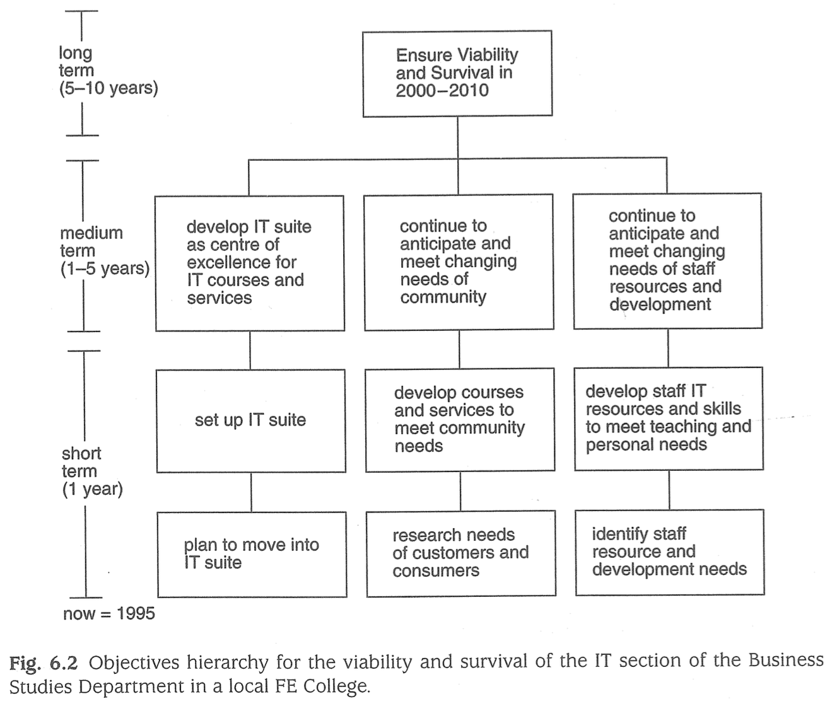
Step 3 Objectives and Constraints

Slide 16
Step 4 Strategies
In some projects, there may be only one realistic pathway to the primary objective.
e.g if objective is reduce the number of grades of hourly-paid workers in a factory from 50 to 25.
In other projects there may be different options.
In complex cases, analyst has to made creative search
two phases: expansion or divergent thinking followed by contraction or convergent thinking.

Slide 17
Step 5 Measures to Assess Achievement
To determine how well a strategy performs in meeting objectives.
Quantitative measures: cost, time, energy, labour, materials, ROI etc.
Quantifiable measures need to be framed in order to set a clear target level
Qualitative measures stemming from the client-set’s world-view
interpretation of declared policies, enthusiasm for a particular technology, effects of potential workplace, workforce morale and attitudes

Slide 18
Step 5 Measures to Assess Achievement
Measurement of assessment must be specified before proceeding to next steps (Modelling, Evaluation).
Quantitative measure will be in next two steps (Modelling, Evaluation).
Qualitative and quantitative measures also important in step8 (Making a Choice).

Slide 19
Step 6 Modelling
Representation of something in the real world or a concept which shows what it looks like or how it works.
In HARD SYSTEMS studies for decision support, models are mainly numerical.
Mathematical models are selected to express relationship between independent variables and dependent variables.
e.g. Assessment measure: cost (step5), this depends on a number of other variables, particularly fixed costs and variable costs.

Slide 20
Step 6 Modelling
In modelling stage we have PV and NPV counting.
Present Value represents the value at today’s price.
Net Present Value is calculated by adding up the present values for each year of the investment period.
PV for each year is calculated from the formula PV = I / (1+i)^{n} where I is the investment sum, i is the annual interest rate and n is the period of investment.

Slide 21
Step 7 Evaluation
Once the model is established at Step6, different sets of likely values for independent variables can be used to calculate corresponding values of the performance measures.
Client and analyst must be aware that such numerical evaluations do not represent certainty.
They are rule-of thumb indicators suggesting that some routes more promising than others.
Degree of uncertainty can be controlled by technique such as decision analysis

Slide 22
Step 8 Making a Choice
Quantitative modelling may be useful for decision-making.
Quantitative evaluation suggests an optimum solution but qualitative evaluation by client may result in a lower performance route being selected.
Based on what is considered to be the most satisfactory rather than numerical best.
A formal presentation to the client-set supported by a detailed project report is a normal requirement at this stage

Slide 23
Step 9 Implementation
Many problem solvers feel that their work has finished at Step8
Planning for implementation and changes which may be involved should be in the minds of both analyst and client-set
Important where major organizational and technical changes are likely
Informing and involving employees from an early stage will help avoid suspicions and worry about ‘secret working-parties’

Slide 24
Summary
Hard system methodology
We want to find approaches to problems, but we should find appropriate one.
REMEMBER ‘Public Transportation Problem’
So, we need systematic intervention.
Problem-solving was not sufficiently systemic.

Slide 25
Summary
There are 9 steps to notice in problem solving using hard systems:
1 - Groundwork
In short, it means identifying and establishing a working relationship with the client set.
2 - Awareness and understanding
The analyst should gain a clear perspective of where the perceived problem fits and what the possible effects of trying to solve the problem will be.
3 - Objectives and constraints
In order to avoid disappointment for the client set, it is essential to draw up clearly defined objectives.
4 - Strategies
In some projects there may be only one realistic pathway to the primary objective. But in many projects distinctly different options are available.

Slide 26
Summary
5 - Measures to assess achievement
To determine how well a strategy performs in meeting objectives
Hard system methodology depends on quantitative ones
6 - Modelling
A representation of something in the real world, which shows either what it looks like or how it works - models are mainly numerical in hard system studies
7 - Evaluation
Result of evaluation might be a set of NPV figures or some other set of data which enables the financial value of each strategy to be compared.
8 - Making a choice
The most satisfactory on all counts rather than the numerical best.
9 - Implementation

Slide 28


